Slide 1

Capstone Project
Airbnb bookings Analysis
By: Keshab Chandra Padhi

Slide 2
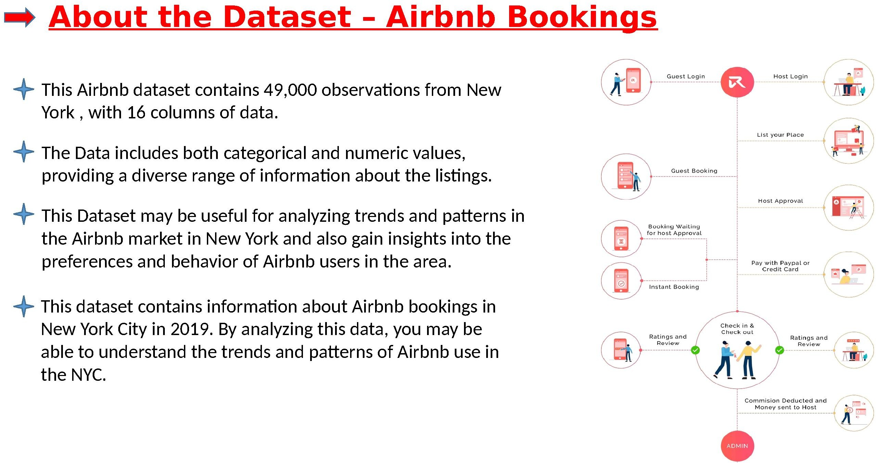

Slide 3
